Slide 1
BANK ANALYTICS PROJECT Visual Reports : Excel Power BI Tableau MySQL

Slide 2
Objective
To study and understand the Loan Data of Customers provided.
Clean the data and prepare a Data Model to work on.
Analyse the data using various Key Performance Indexes.
Prepare visual reports using interactive analytical tools :
Excel
Power BI
Tableau
MySQL
Provide insights & suggestions based on the final analytical outcomes.

Slide 3
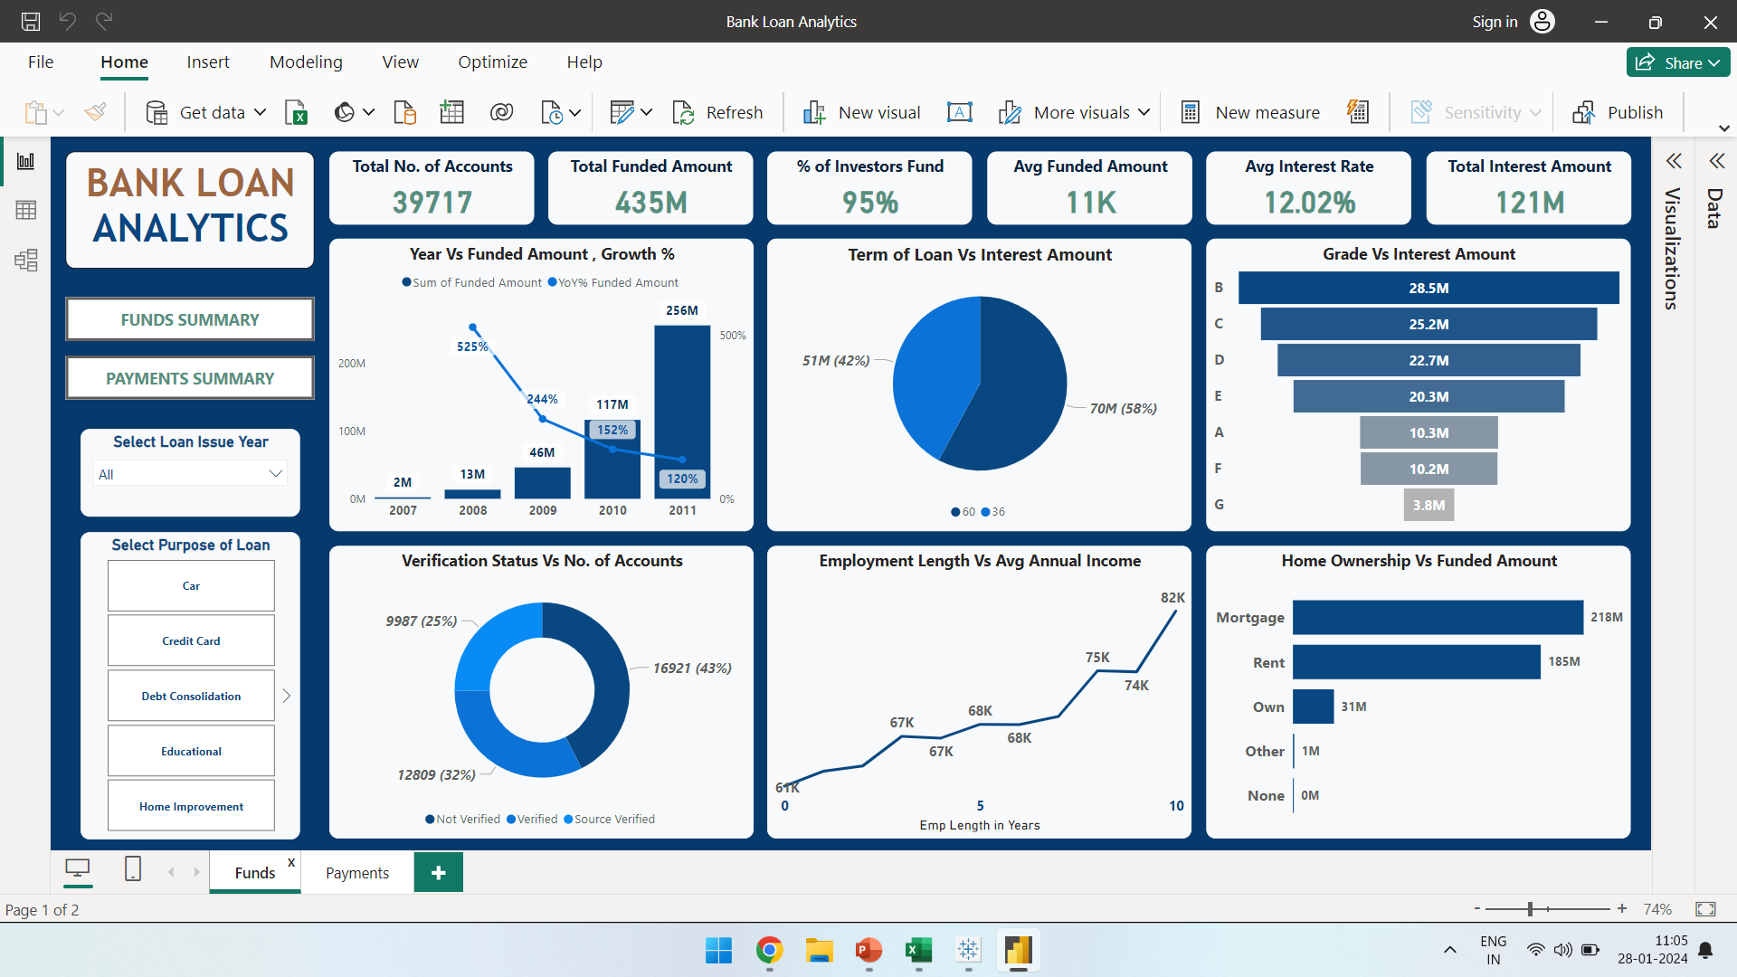
Power BI Dashboard

Slide 4
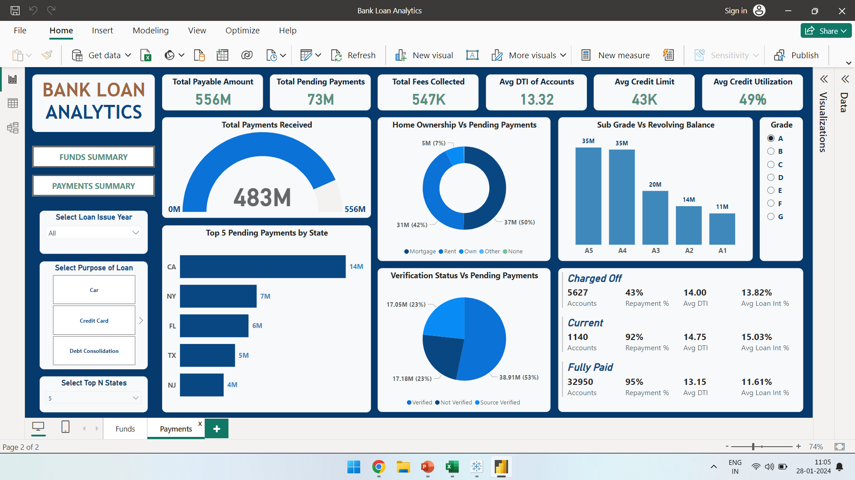
Power BI Dashboard

Slide 5
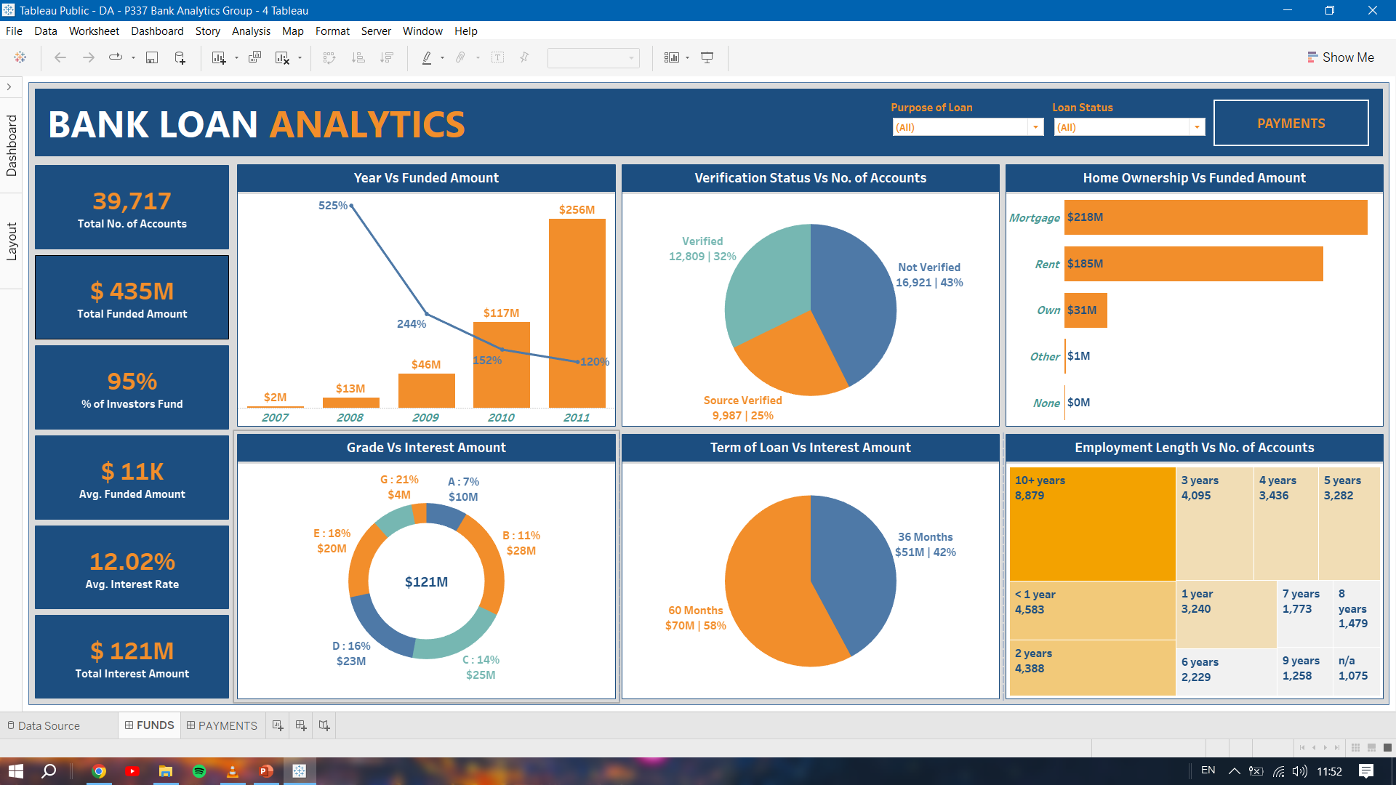
Tableau Dashboard

Slide 6
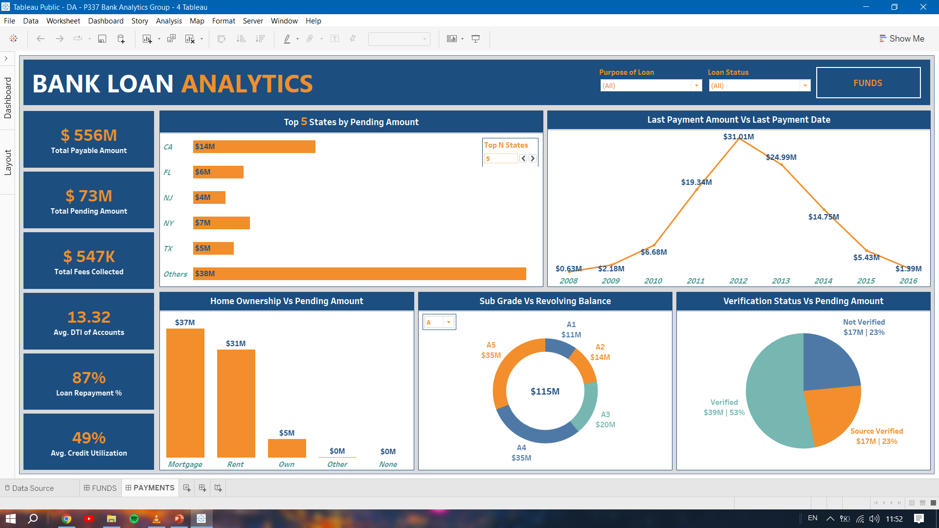
Tableau Dashboard

Slide 7
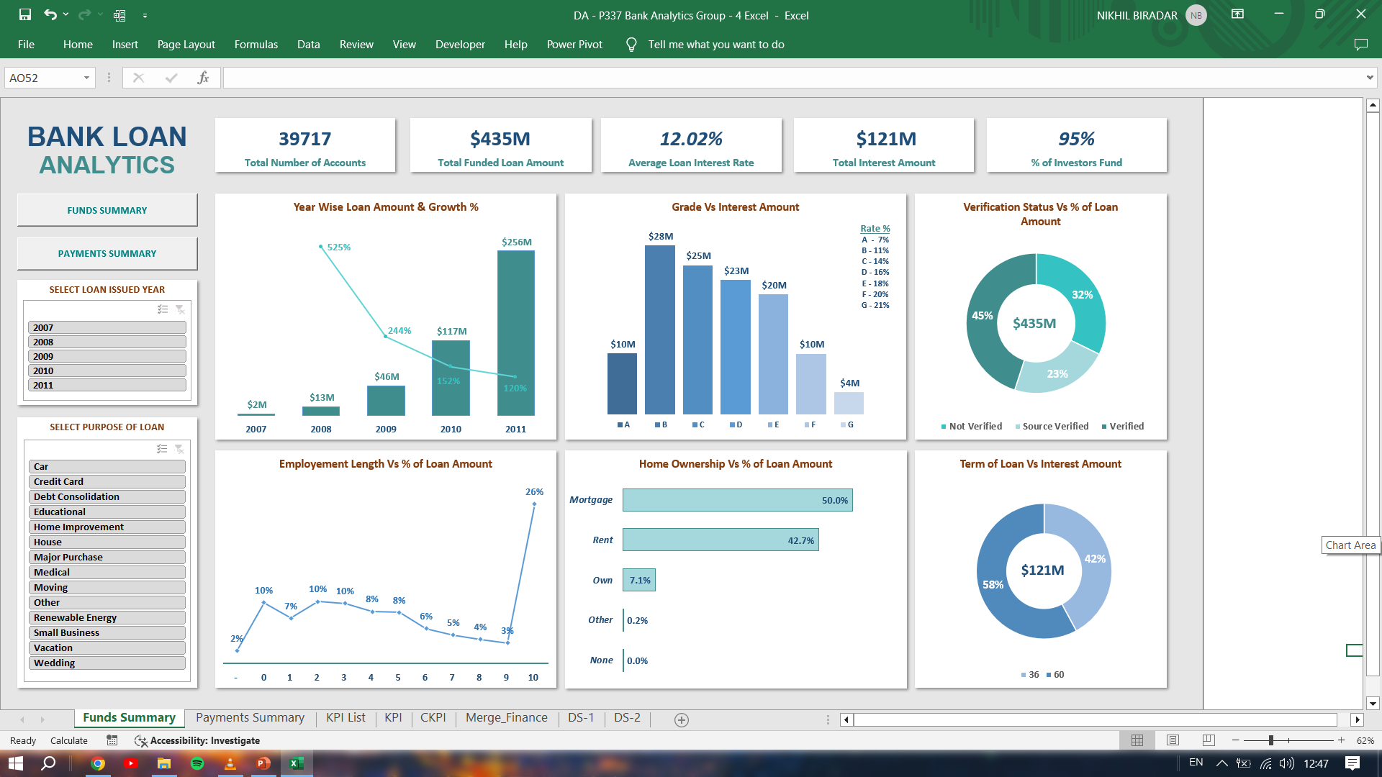
Excel Dashboard

Slide 8
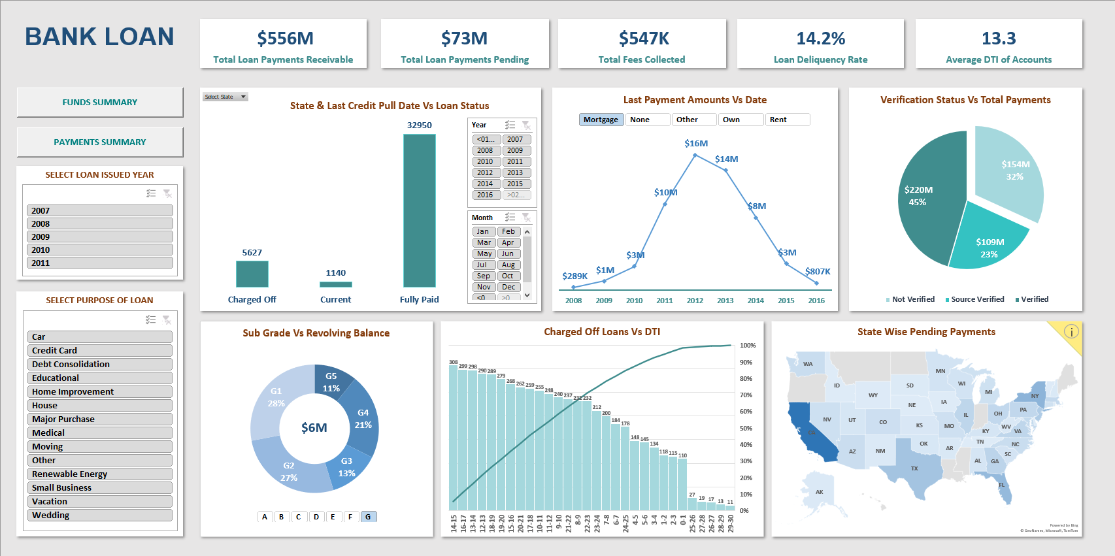
Excel Dashboard

Slide 9
Indicators
Total Number of Accounts
Total & Average Funded Amount
Percentage of Investors Fund in Total Funded Loan Amount
Average Loan Interest Rate
Total Interest Amount Generated
Total Receivable and Pending Loan Payment Amount
Total Fee Amount Accumulated
Loan Repayment Percentage
Average DTI of Accounts
Average Credit Limit and Credit Utilization Rate

Slide 10
KPI
Funded Loan Amount based on
Loan Issued Year & Growth %
Verification Status
Employment Length
Home Ownership
Number of Accounts based on
Verification Status
Employment Length
Loan Status
Interest Amount Generated based on
Term of Loan
Grade of Loan

Slide 11
KPI
Pending Loan Payment Amount based on
State
Verification Status
Home Ownership
Loan Status vs Average DTI – Pareto Analysis
Grade & Sub Grade wise Revolving Balance
Last Payment Amount vs Last Payment Date based on Home Ownership
State & Last Credit Pull Date wise Loan Status
All the mentioned KPI have Page level filters based on Year Issued Date, Purpose of Loan to provide more detailed interactions between visuals.

Slide 12
Insights / Suggestions
The Bank can use the indicators to avoid a potential Charged Off Loan :
Term of Loan of 36 months account to 60% of the Loans
Customer DTI ranging from 9 – 20 account to 80% of the Loans
Not Verified Accounts account to 40% of the Loans
Employment Length of 1,2,10+ years account to 50% of the Loans
Purpose : Debt Consolidation account to 50% of the Loans
Accounts from states : CA, FL, NY, TX, NJ account to 50% of the Loans
Credit Utilization Rate > 60%
Home Owner ship : Rent account to 50% of Loans
Grade of Loan : D, E, F, G Grade Loans account to 40% of Loans

Slide 13
Insights / Suggestions
The YoY Growth % of Funded Loan Amount is gradually decreasing even though the YoY Growth % of Number of Accounts is increasing. Based on the Current Trend, the Funded Amount for the 2012 would be $ 380M which is only 50% greater compared to 2011. The Bank can target customers with more than 8 years of emp length who require Average Loan Amount of > $ 12K in order to increase the Funded Amount.
Loan Accounts having Higher Average Interest Rates have more Percentage of Charged Off Loans. 30% of the Grade D, E, F, G Loans are Charged Off. The Bank could prefer to not provide more number of loans to these Accounts as Percentage of Pending Payments from these loans is 30% compared to less than 20% in other grades.
The Term of Loan of 60 Months is generating 60% of the Total Interest Amount due to Higher Average Interest Rate. The Bank can push the customers to go for longer loan term to generate much more profits.

Slide 14
Thank You Have a Good Day !

